Slide 1
WCSD Professional Learning Framework Overview Certified Staff and Site-level Leadership
Katie Weir and Amy Wright
Human Resources – Department of Talent Development
May 2025

Slide 2
Shifting Roles Activity Reflecting Teamwork and Change Management
How did different roles change the team dynamic and ability to accomplish even a simple task?
How does this relate to real roles in your schools?
Notes:
Teams of 6-8 depending on the size of the group
Round 1 – Team performs a simple task, build the tallest tower using only the cups.
Round 2 – Assign roles, perform the same task and reflect as a team.
Explore how different roles impact teamwork and collaboration during change.
Build understanding of how perspectives shift when managing change within a team.
Promote flexibility, adaptability, and communication skills as leaders.

Slide 3

“Leadership is collective mobilization.”
-Michael Fullan

Slide 4
Learning Intentions and Success Criteria
I am learning about WCSD's professional learning framework and the rollout of priority-area based professional learning district-wide.
I can use the information provided to effectively communicate my school's needs and area of focus, in relation to the priority-area based model, to my site leadership team and Area Superintendent.
I can connect content between my school’s possible focus and WCSD’s other identified professional learning priority areas.
I can identify the three levels of the professional learning framework.

Slide 5
Professional Learning Priority Areas Schools intentionally organized to engage in professional learning over time.
Teacher Clarity
Systems/Behavior
Science of Reading (ES/MS)
Supporting Diverse Learners in a Secondary Classroom (HS)
All areas will build a foundation and awareness of the connections between all three learning opportunities.

Slide 6
A Balanced Approach:
Instruction + Access + Conditions for Learning
Teacher Clarity | Systems and Behavior | Science of Reading | Supporting Diverse Learners in a Secondary Classroom
Provides a District framework for Tier I instruction. Anchors lessons in clear learning intentions, success criteria, and assessment. . Promotes student ownership in their learning. Effect Size: 0.85 | Builds strong Tier I supports and routines. Enhance school culture. Supports pro-active systems for managing student behavior. | Prioritizes explicit instruction in decoding, language and comprehension. Replaces outdated strategies with research- based practices. Ensures all students can become skilled, confident readers. | Prioritizes equity and access using evidence-based strategies. Builds capacity of secondary educators to utilize strategies to meet the needs of all learners.

Slide 7
Unifying Thread for all Focus Areas: Connectedness
Why?
Students engage when they feel valued, safe, and represented
Strong relationships and clear expectations reduce behavioral issues
Academic growth accelerates when students feel seen and supported
Belonging is fundamental – students must feel connected to access rigorous learning
How?
Overview of strategies to build strong relationships and develop a sense of belonging are embedded into all formal trainings
Collect and review student and staff connectedness data
Embed and promote practices that promote relational trust, cultural responsiveness, and inclusive environments across focus areas.
Notes:
STS perceptions of adult respect, relationships
Connecting kids to the school community – breaking down barriers to get kids to school
FOCUS – on meaningful relationship building

Slide 8
Professional Learning Days
Wednesday, August 6th or Thursday, August 7th
Monday, October 13th
Monday, January 5th

Slide 9


Understanding Your Focus Area
In consultation with your Area Superintendent, you will focus on a designated priority area each year.
This focus will guide your professional learning and planning for the year.
Important: Your focus area is a spotlight, not a silo.
While you'll dive deeper into one area, you’re still responsible for engaging in all leadership areas to support school-wide success.
Notes:
Not discreet – we've chosen 3 high impact areas– why these 3 things? We know it's not exhaustive.
What would you need as a leader and learner to roll this out? Add reflection.
As an organization in order to be able to support you well, we need to focus in three areas.

Slide 10
Priority Areas Defined
Teacher Clarity
Expectation will be to focus on implementation of LISC and assessment practices
Behavior and Systems
Expectation will be to focus on implementation of consistent Tier 1 routines, behavior expectations, and system improvements
Science of Reading
Expectation will be to focus on implementation of explicit reading strategies and use of diagnostic data to support reading growth
Supporting Diverse Learners in a Secondary Classroom
Expectation will be to focus on implementation of evidence-based strategies that support access to grade-level content for all learners.

Slide 11
Linking to August Back-to-School Professional Learning Offerings
Tuesday, August 5th – Site-Based Staff Specific PL
Wednesday, August 6th –
District-wide PL Teacher Clarity Priority Area Kick-Off
or
2-3 hour principal-led training on non-priority focus & Site-Based PL
Thursday, August 7th –
District-wide Science of Reading, Systems and Behavior, and Diverse Learners Priority Area Kick-Off
or
2-3 hour principal-led training on non-priority focus & Site-Based PL
Friday, August 8th – Teacher Workday
Notes:
Proposed Schedule:
August 5th - Site specific PL, staff meeting, planning, etc.
August 6th - District-wide PL - Teacher Clarity – FULL DAY
Other cohorts - site based Teacher Clarity (principal discretion-non-cohort 1 school) - 2-3 HOURS
August 7th - FULL DAY District wide PL - Systems and Behavior/Science of Reading /
other cohort - site based choice: Science of Reading or Systems/Behavior (principal discretion) 2-3 HOURS
August 8th - Teacher Workday

Slide 12
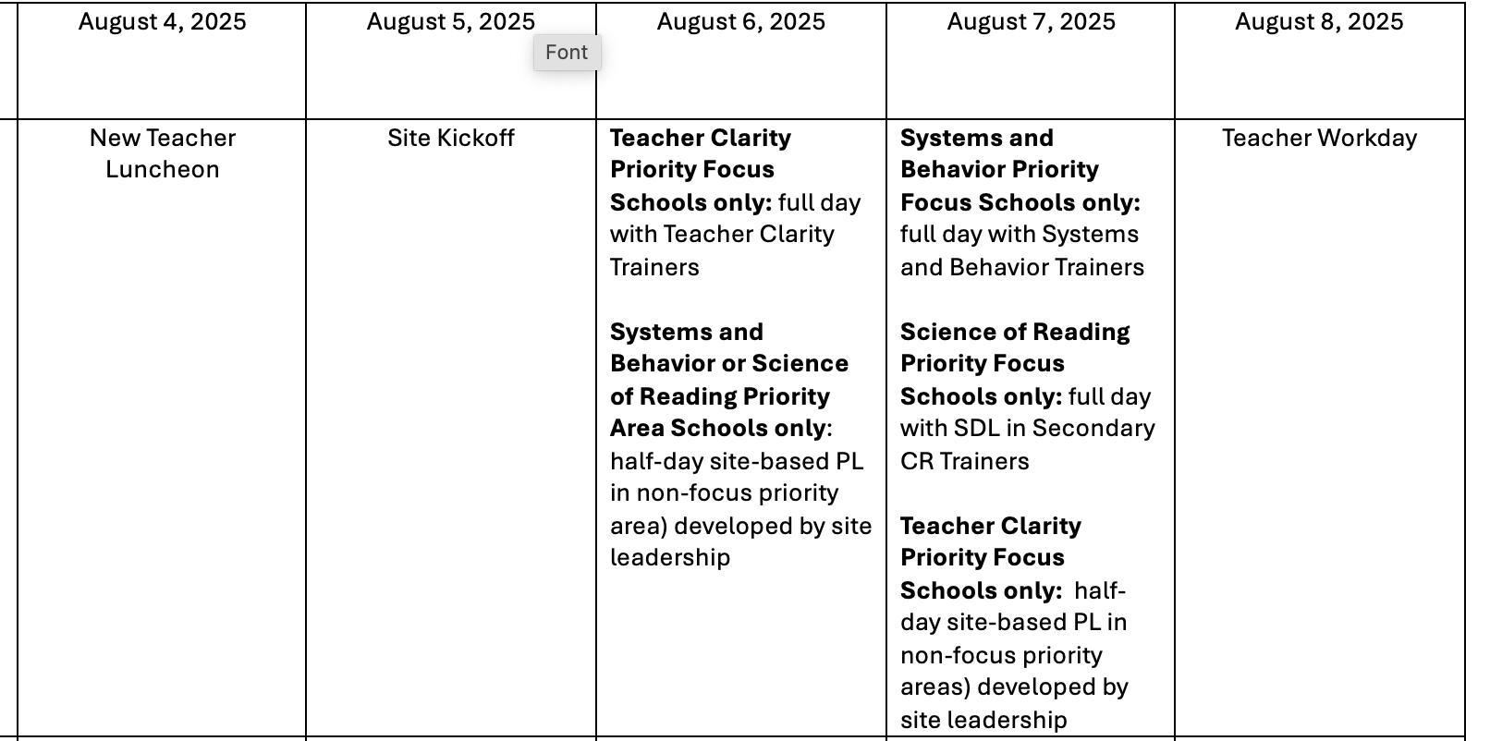
August BTS PL Schedule – MS/ES

Slide 13
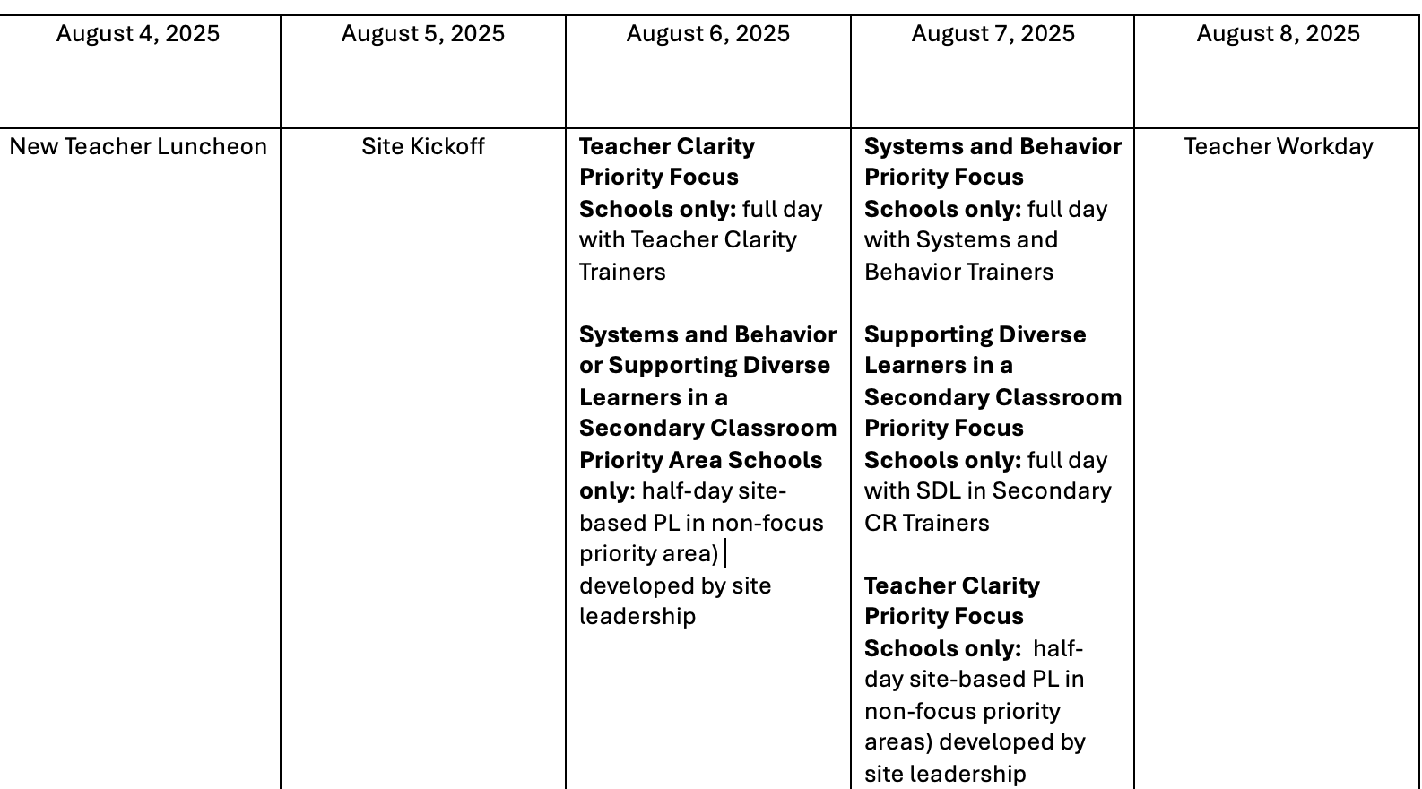
August BTS PL Schedule - HS

Slide 14
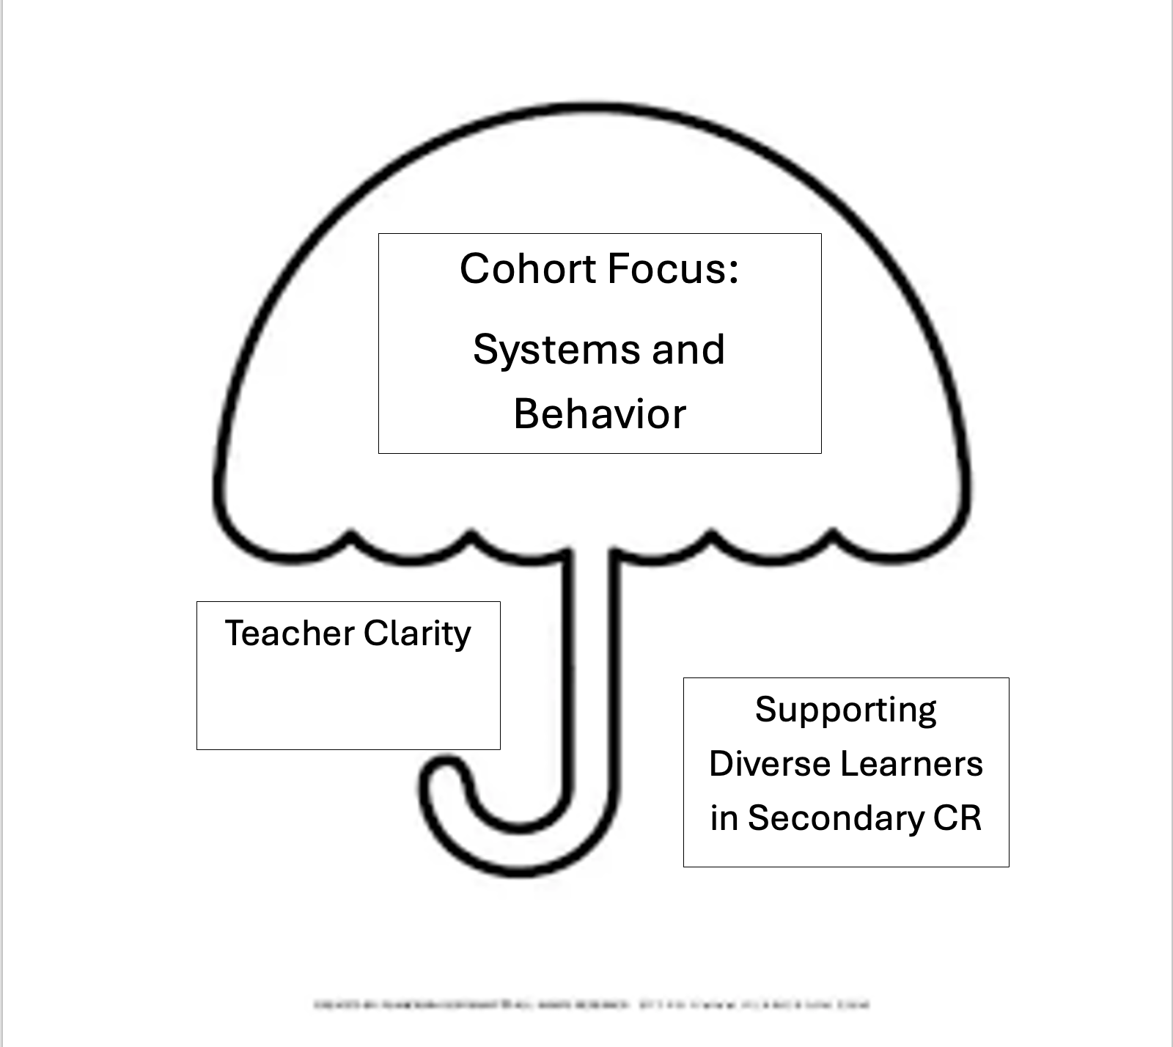
Connecting the Priority Areas
Notes:
Work in groups to brainstorm possible connections between cohorts that you will engage your staff in during site prof learning.
Handout – 9-12
Assign groups a focus area.

Slide 15
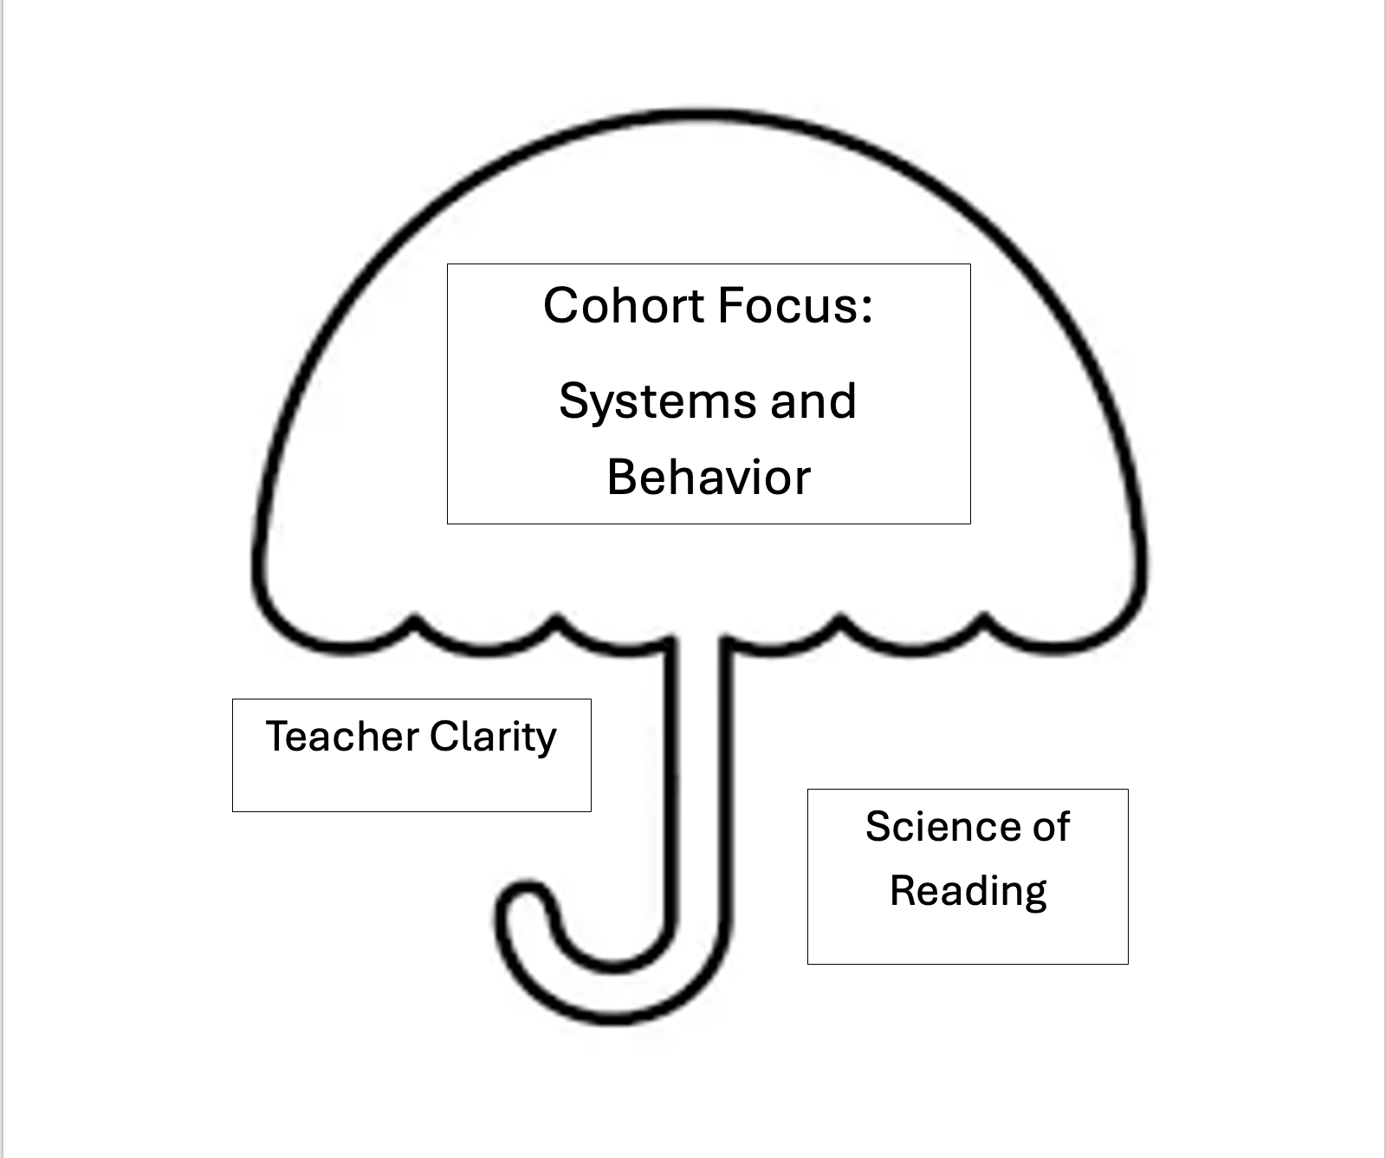
Connecting the Priority Areas
Notes:
Work in groups to brainstorm possible connections between cohorts that you will engage your staff in during site prof learning.
Handout – 9-12
Assign groups a focus area.

Slide 16
Teacher Clarity Focus Area Example:
Science of Reading/Supporting Diverse Learners Connections
Use clarity practices to write learning intentions/success criteria for foundational literacy skills
Embed engagement strategies or SoR-aligned look-fors in reading instruction walkthroughs
Send key staff to PL
Behavior & Systems Connections
Apply clarity to schoolwide expectations and routines
Review behavior data to assess classroom routines and procedures
Pilot one behavioral system improvement using clear, shared expectations

Slide 17
Behavior and Systems Focus Area Example:
Teacher Clarity Connections
Use learning intentions and success criteria to clarify expectations for routines and systems
Model clear goals and success criteria in PLCs and staff meetings
Align schoolwide systems with instructional clarity tools (e.g., clarity-aligned walkthrough tools)
Science of Reading/Supporting Diverse Learners Connections
Ensure Tier 1 schedules protect time for foundational reading instruction
Use behavior data to support engagement during Tier I instruction
Include aligned practices for classroom expectations during instructional blocks

Slide 18
Supporting Diverse Learners Focus Area Example:
Teacher Clarity Connections
Write clear learning intentions and success criteria for foundational literacy skills
Ensure the alignment of literacy standards to tasks and activities
Reinforce how clarity modules support student’s understanding and engagement in reading
Behavior and Systems Connections
Align SoR instruction with Tier 1 systems (e.g., consistent routines during literacy blocks)
Monitor reading time transitions and engagement as part of schoolwide behavior efforts

Slide 19
Science of Reading Focus Area Example:
Teacher Clarity Connections
Write clear learning intentions and success criteria for foundational literacy skills
Ensure the alignment of literacy standards to tasks and activities
Reinforce how clarity modules support student’s understanding and engagement in reading
Behavior and Systems Connections
Align SoR instruction with Tier 1 systems (e.g., consistent routines during literacy blocks)
Monitor reading time transitions and engagement as part of schoolwide behavior efforts

Slide 20
Engage and Elevate: WCSD Professional Learning Framework

Slide 21
Framework Overview
This multi-year framework ensures coherence within our district’s strategic approach to professional learning, ensuring alignment with our district-identified priorities for student learning through three lanes: professional excellence, systems, and compliance.

Slide 22
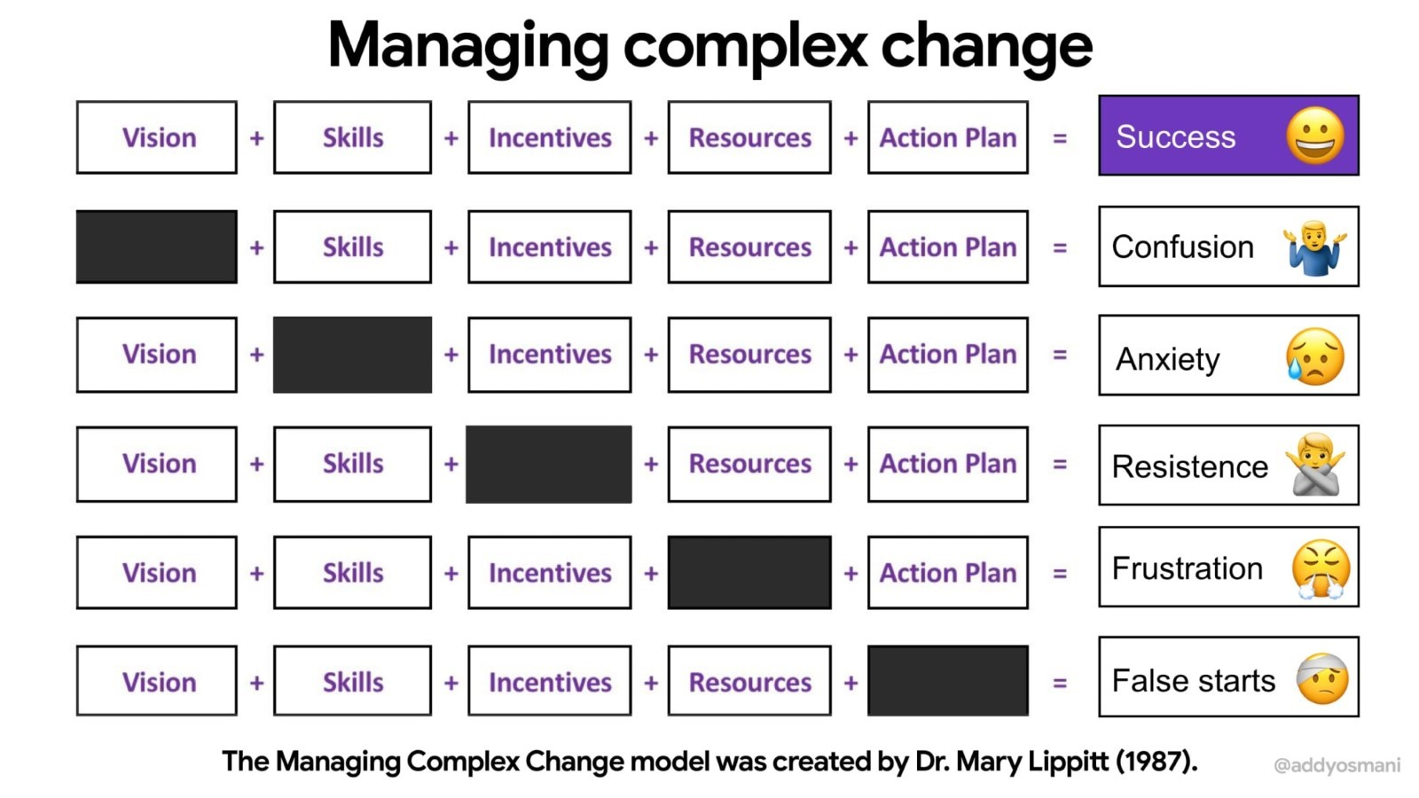
Notes:
Bringing you back to this visual when managing complex change –
Incentives/Motivation

Slide 23
Framing our Learning
Think through your professional learning, preparation, support, and training in regard to your readiness as a principal.
Rate the level of effectiveness in these areas (1 – 3):
Compliance
Systems
Professional Excellence
Notes:
Reflect on your professional learning journey as a principal –
Our new professional learning framework is grounded in learning progressions across three key areas: compliance, systems-thinking, and professional excellence. Today, we’ll begin by honestly reflecting on where we are now—both individually and as school communities—to inform where we’re headed.
Post-it-notes to capture thinking and place on posters throughout the room. Provide a bit of a rationale.

Slide 24

Notes:
Clearly, our variable experiences for 1 of many cohorts of professionals within WCSD speaks to a shift in our approach to developing and providing professional learning.

Slide 25
Professional Development Framework Example:
Incorporating Guiding Principles within Large-scale Professional Practice – Model at Scale
Capacity Building within Guiding Principles – Develop Others Through the Principles
Engage Level 2
Engage Level 3
Engage Level 1
Engage Level 4
Guiding Principles Overview –Grounded in Purpose
Integrating Guiding Principles within Your Daily Practice – Lead with Intention
Compliance
Systems
Professional Excellence
Labor Relations 101: Understanding the Contracts you Oversee
Labor Relations 102:
Clear, Concise, and Consistent Communication
Labor Relations 104:
Resolve with Respect
Labor Relations 103: Uphold Professional Standards
Labor Relations Systems 101:
Contract Literacy
Labor Relations Systems 102:
Communication Structures
Labor Relations Systems 103:
Aligning Accountability Processes Site-Wide
Labor Relations Systems 104: Association Partnerships
Understand Apply Analyze Evaluate Create
Notes:
Compliance Example –
Session 1: Know What You Govern Understanding the contracts, agreements, and policies you are responsible for implementing.
Session 2: Communicate with Clarity and Consistency Practicing effective, contract-aligned communication with employees and association partners.
Session 3: Uphold Professional Standards Navigating performance management, accountability, and standards of conduct with confidence.
Session 4: Resolve with Respect Engaging in collaborative problem-solving, conflict resolution, and interest-based dialogue to maintain strong, professional relationships.
Systems Example –
Labor Relations Through a Systems Lens
Session 1: Build Contract Literacy into Leadership Systems Ensure your leadership teams understand and integrate collective bargaining agreements into everyday decision-making and planning.
Session 2: Design Communication Structures That Prevent Misinformation Establish proactive, transparent communication systems between site leadership, employees, and associations to foster trust and reduce conflict.
Session 3: Align Accountability Processes Across Sites Develop consistent, equitable systems for tracking performance concerns, documenting interventions, and applying progressive discipline district-wide.
Session 4: Create Feedback Loops for Continuous Labor Partnership Implement data-informed processes for resolving concerns, identifying patterns, and strengthening collaboration with labor groups over time
-
Professional Excellence Through the Lens of Guiding Principles
Session 1: Grounded in Purpose Explore the district’s Guiding Principles and reflect on how they shape leadership identity, expectations, and decision-making.
Session 2: Lead with Intention Identify ways to apply the Guiding Principles in daily leadership interactions, team meetings, and decision-making moments.
Session 3: Model at Scale Design professional learning, communication, and staff engagement strategies that visibly reinforce the Guiding Principles at the schoolwide level.
Session 4: Develop Others Through the Principles Build leadership capacity across your team by embedding the Guiding Principles into coaching, feedback, hiring, and succession planning practices

Slide 26
Opportunities for Planning/Input
Content Specific Opportunities
Teacher Clarity – members set
Other content-specific opportunities TBD
Role Specific Opportunities
Please indicate on the feedback survey at the conclusion of today's Academy if you are interested in learning more and possibly joining the planning for 25-26 and beyond.
Notes:
Communicate opportunities to engage more fully in this work! ☺

Slide 27
Learning Intentions and Success Criteria
I am learning about WCSD's professional learning framework and the rollout of cohort-based professional learning district-wide.
I can use the information provided to effectively communicate my school's needs and area of focus, in relation to the cohort-based model, to my site leadership team and Area Superintendent.
I can connect content between my school’s possible cohort focus and WCSD’s other identified professional learning priority areas.
I can identify the three levels of the professional learning framework.

Slide 28
Call to Action
What factors will I consider when identifying the most appropriate priority for my school?
“Based on our current priorities, data, and staff needs, the area that seems most appropriate is ___ because ___.”
What professional learning opportunity would be most valuable for my own growth as a leader?
“A meaningful learning opportunity for me personally would be ___, as it would strengthen my ability to ___.”
How will I clearly and effectively communicate our school’s needs to my Area Superintendent?
“To ensure alignment and support, I plan to communicate our focus area by ___ and highlight our needs through ___.”
Notes:
As you prepare to engage with your site leadership team and Area Superintendent, consider:

Slide 29

Survey Link

Slide 30
District Professional Learning Vision Draft:
Engage and Elevate
The WCSD Professional Learning Framework fosters growth, alignment, and organizational excellence through a cohesive, evolving system. The framework enhances collaboration, supports staff, and advances student outcomes with clear structure, shareholder input, sustainable development, and a dedication to continuous improvement.

